Slide 1
Globalization and A Few Immerging Issues
Globalization is the process of integrating various economies of the world without creating any hindrances in the free flow of goods and services, technology, capital and even labor or human capital.
Globalization facilitate deeper integration with the world economy through trade, flows of information technology, finance, and migration that offer renewed and enhanced opportunities to increase productivity and raise incomes.

Slide 2
This benefits both the producers and the consumers
Producers participating in bigger international markets benefit from the larger scale production, access the most appropriate technology and knowledge, and by participating in increasingly integrated global production chains. Whereas,
Consumers usually have access to a wide range of latest international products.

Slide 3
Issues coming up with globalization in recent times may be:
growing economic weight of developing countries in international economy,
productivity growth through global production system,
accelerated diffusion of technology through falling communications costs and improved access to telecommunications and the Internet, as well as through innovative forms of business organization, often linked to foreign investment.

Slide 4
growing inequality,
pressure in labor markets, and
threats to the global commons

Slide 5
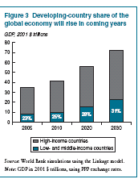

Slide 6
the ratio of trade to GDP—will rise
A growing share of global production of goods and services will be performed in the developing countries that able to take advantage of new opportunities.

Slide 7
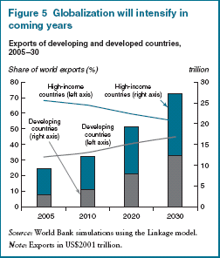

Slide 8
Technological improvements, more innovation in business processes that allow for an acceleration of globalization, and widespread adoptions of good policies within countries will generate better results.
Greater integration promotes knowledge about policies that work. It also shortens the duration of bad policies, as investment capital and human resources can more readily flee poorly performing nations. That discipline is likely to become more effective as financial, merchandise, and technological markets continue to integrate.

Slide 9
The benefits of globalization are likely to be uneven across regions and countries.
Africa, because of underlying growth trends and the presence of many fragile states, is the region most likely to fall farther behind. But, it also has the most to gain from integration, because it can take advantage of technology and wage gaps to propel higher sustained growth.

Slide 10
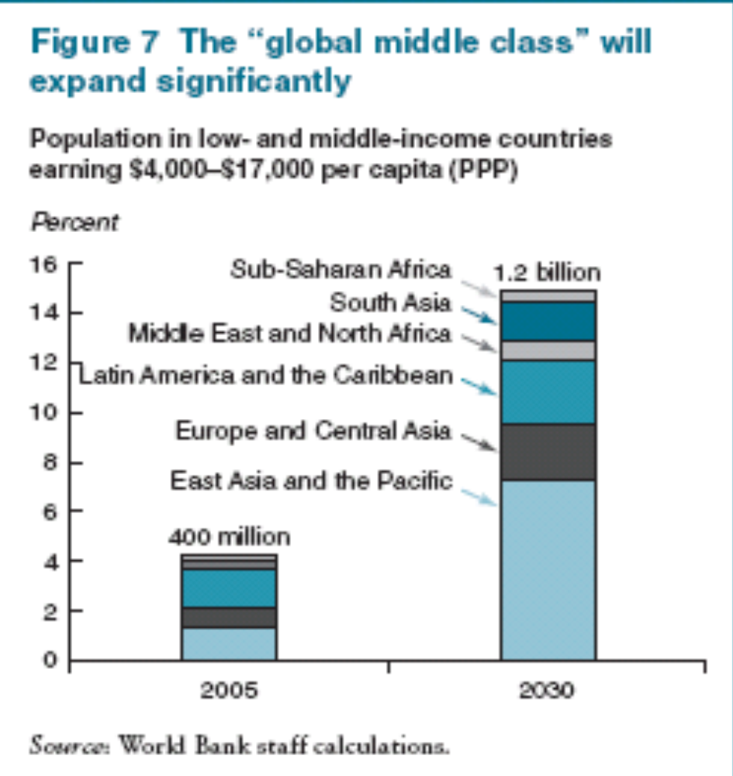

Slide 11
Some social groups may be left behind or even marginalized in the growth process.
Unskilled workers, in particular, may fall farther behind.
Technological progress, by generating demand for greater skills, tends to widen the gap between the wages of skilled and unskilled workers.

Slide 12
While developing countries are closing the income gap with rich countries, as many as two-thirds—more than 80 percent of the developing world outside China—may experience a worsening of within-country inequality, thus muting the poverty-reducing effects of growth and fanning social tensions that could derail growth.
There will be widening difference in earning potential between skilled and unskilled workers. This is because investments in capital and technology create a more rapidly growing demand for skilled workers.

Slide 13
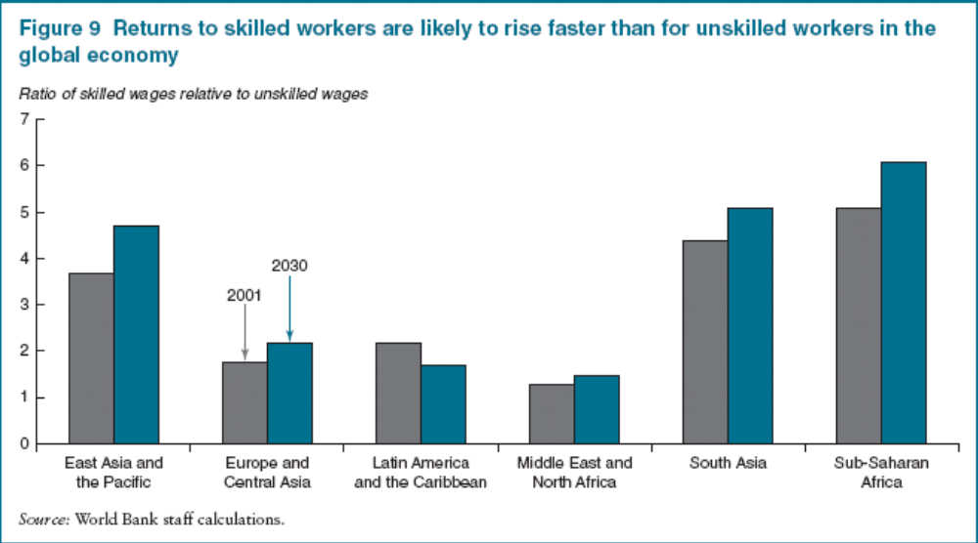

Slide 14
Several policies can lead to more egalitarian countries and a more egalitarian world. Governments can create new opportunities for the poor through additional investments in education. Investments in girls’ education can be an important complement to reducing gender discrimination in the workplace. Additional resources for education and other pro-poor investments are likely to become available from a tax base centered on a growing middle-class.
Moreover, increasing development assistance for lagging regions and the poorest countries—and making that assistance more effective—is critical.

Slide 15
Particularly important are investments to overcome bottlenecks in infrastructure, education, and health.
Globalization offers opportunities for export growth and access to a wider range of cheaper imported products that can fuel productivity growth and raise average living standards. But by creating a progressively more integrated global market for labour, it imposes adjustment costs on certain groups within countries, exerting downward pressure on some wages, decreasing job security, and making retraining and relocation necessary.

Slide 16
Even though wages of unskilled workers in virtually all countries have risen as productivity has increased with globalization, the unskilled have received wage increases that are lower than those for skilled workers—and they have experienced greater difficulty in sustaining their employment.

Slide 17
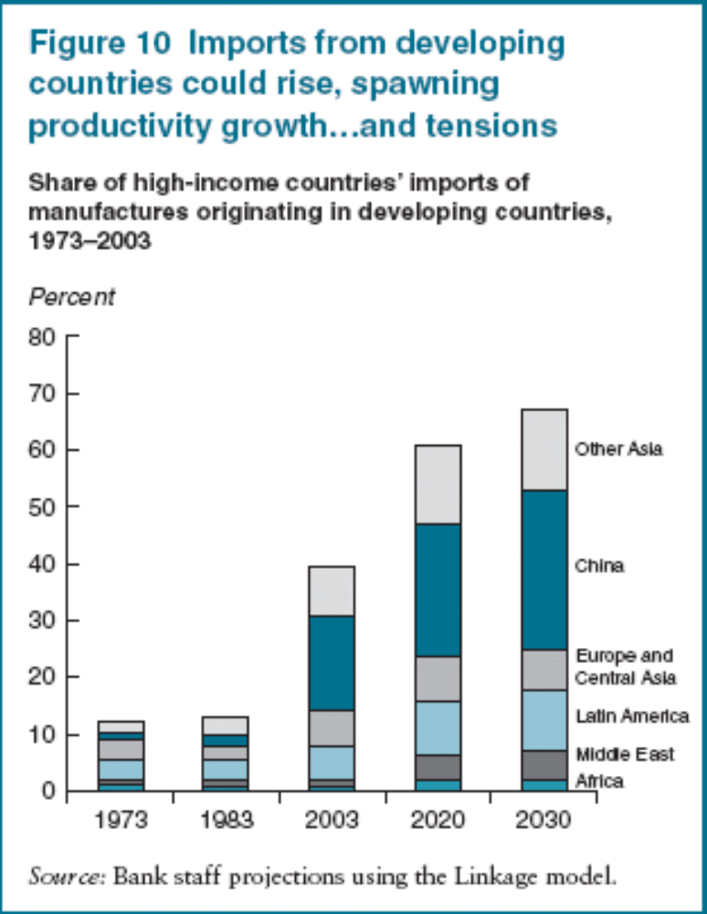

Slide 18
In the context of India and China
Many developing countries fear that exports from these large new players may swamp their domestic markets, squeeze them out of the global export market, foreclose avenues of diversification in manufactures as a road to higher growth, and soak up the pool of foreign direct investment (FDI).
High income countries worry that if the large emerging economies can readily acquire and master the newest technologies, their exports may soon take over high-tech markets.

Slide 19
